Slide 1


Muhammed Rabeeh
26 March 2022

Slide 2

Outline
Executive Summary
Introduction
Methodology
Results
Conclusion
Appendix

Slide 3
Executive Summary
Summary of methodologies
Data Collection through API and Webscraping
Data Wrangling
EDA With SQL
EDA with Data Visualization
Building an Interactive Map With Folium
Building a Dashboard With Plotly
Machine Learning Prediction
Summary of all results
Exploratory Data Analysis result
Interactive analytics in screenshots
Predictive Analytics result

Slide 4
Introduction
Project background and context
In this project we will predict if the Falcon 9 first stage will land successfully. SpaceX advertises Falcon 9 rocket launches on its website with a cost of 62 million dollars; other providers cost upward of 165 million dollars each, much of the savings is because SpaceX can reuse the first stage. Therefore if we can determine if the first stage will land, we can determine the cost of a launch. This information can be used if an alternate company wants to bid against SpaceX for a rocket launch
Problems you want to find answers
What are the factors influences the successful launch of rocket ?
What are the operation condition that need to be taken to ensure successful landing?
How the various variables depends upon the success rate ?

Slide 5

Section 1

Slide 6
Methodology
Executive Summary
Data collection methodology:
Data was collected using Spacex API and webscraping
Perform data wrangling
One hot encoding data fields and dropping irrelevant columns
Perform exploratory data analysis (EDA) using visualization and SQL
Perform interactive visual analytics using Folium and Plotly Dash
Perform predictive analysis using classification models
How to build, tune, evaluate classification models

Slide 7
Data Collection
Dataset was collected by using get request to Spacex Rest API .
Downloaded the .json file
Parsed the information into a dataframe
Performed basic cleaning and formatting of the data
We also collected the data using webscraping by BeautifulSoup

Slide 8
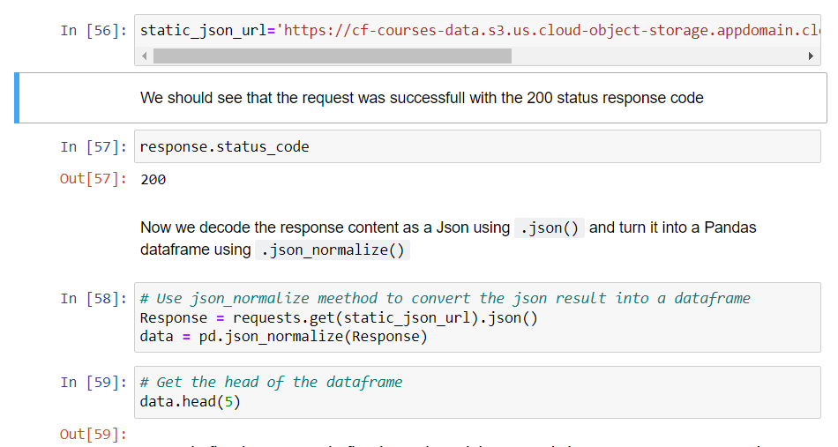
Data Collection – SpaceX API
Data was collected using get request to Spacex API and then we cleaned data ,filtered the dataframe and export into csv file .
GITHUB LINK

Slide 9
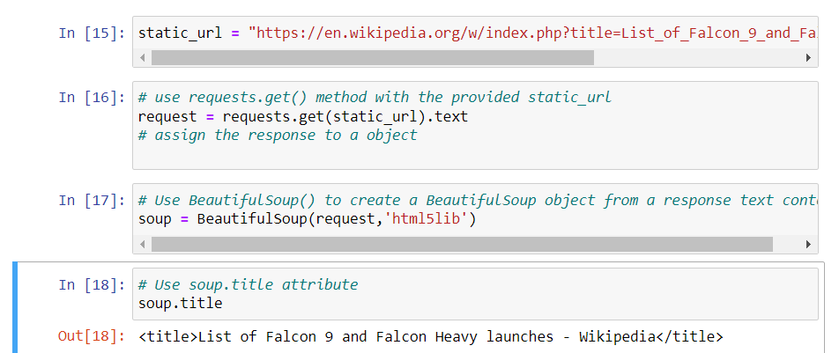
Data Collection - Scraping
Data was collected using webscraping with BeautifulSoup and the created the beautifulsoup object,creating the dictionary and finally converting the dataframe into .csv file.
GITHUB LINK

Slide 10
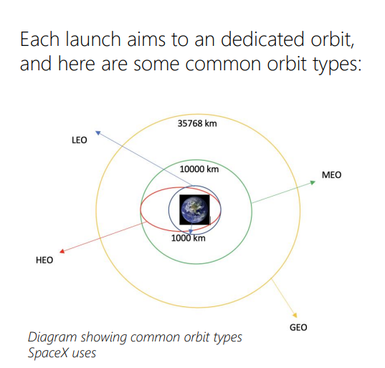
Data Wrangling
In this we performed to EDA to find some patterns in the data and determine what would be the label for training supervised models.
At first we calculated the number of launches on each site
We then calculated the number of occurrence of each orbit.
Created the landing outcome from outcome column
And exported the results into csv file.
GITHUB LINK

Slide 11

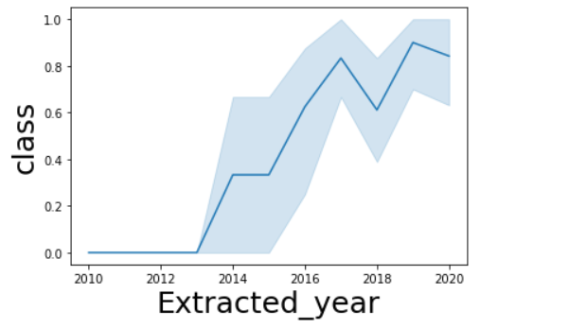
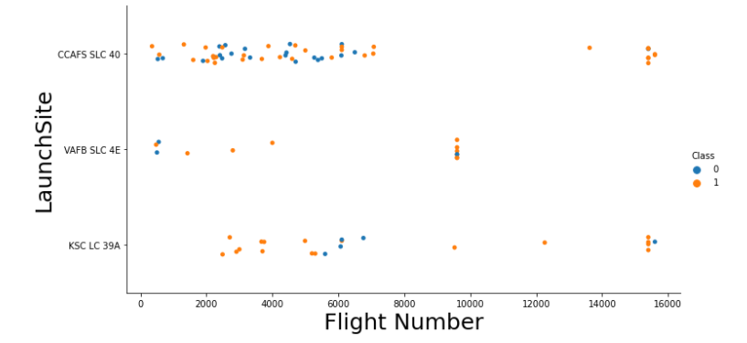
EDA with Data Visualization
We explored the data by visualizing the relationship between :
Flight Number VS. Payload Mass
Flight Number VS. Launch Site
Payload VS. Launch Site
Orbit VS. Flight Number
Payload VS. Orbit Type
Orbit VS. Payload Mass
GITHUB LINK

Slide 12

EDA with SQL
Here we performed sql queries to get better understanding of the data,following are the queries :
names of the unique launch sites in the space mission
records where launch sites begin with the string 'CCA'
average payload mass carried by booster version F9 v1.1
total number of successful and failure mission outcomes
names of the booster_versions which have carried the maximum payload mass
failed landing_outcomes in drone ship, their booster versions, and launch site names for in year 2015
GITHUB LINK

Slide 13

Build an Interactive Map with Folium
Using the folium package,we performed more interactive visual analytics,which includes :
Displaying all launch sites on the map
Displaying success and failed launches for each site on the map
Explored and analyzed the proximities of launch sites
GITHUB LINK

Slide 14
By using plotly dash,we made a dashboard that shows:
pie charts showing the total launches by a certain sites
scatter graph showing the relationship with Outcome and Payload Mass (Kg) for the different booster version
GITHUB LINK
Build a Dashboard with Plotly Dash

Slide 15

Predictive Analysis (Classification)
We loaded the data using numpy and pandas, transformed the data, split our data into training and testing.
We used GridSearchCV to find the best parameters.
We fit the model the models with training data using best parameters.
Finally we tested the model using testing data and computed accuracy score and plotted confusion matrix.
We found the best performing classification model.
GITHUB LINK

Slide 16
Results
Exploratory data analysis results
Interactive analytics demo in screenshots
Predictive analysis results

Slide 17

Section 2

Slide 18
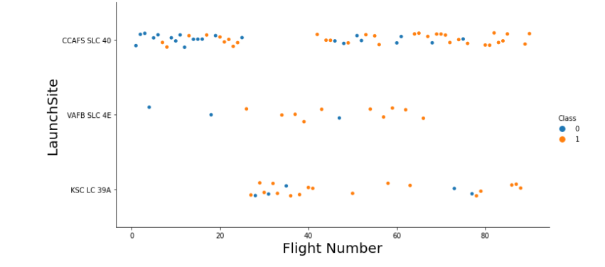
Flight Number vs. Launch Site
We found that the larger the flight amount at a launch site, the greater the success rate at a launch site and also KSC LC-39A seems to be the most consistent.

Slide 19
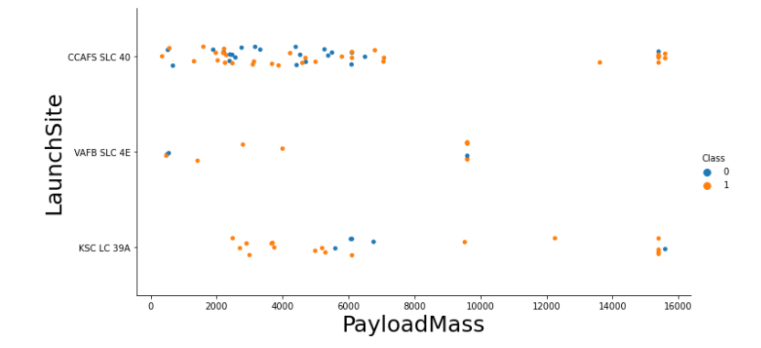
Payload vs. Launch Site
We founded that greater the payload mass for launch site higher the Success rate for the rocket.

Slide 20
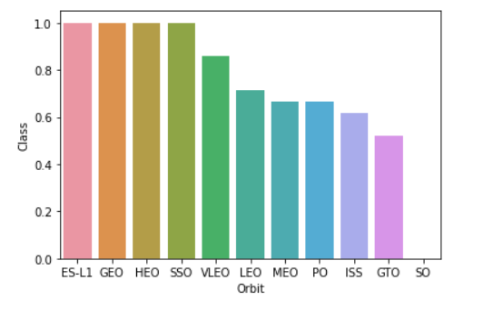
Success Rate vs. Orbit Type
We founded that orbit ES-L1, GEO, HEO, SSO, VLEO had the most success rate.

Slide 21
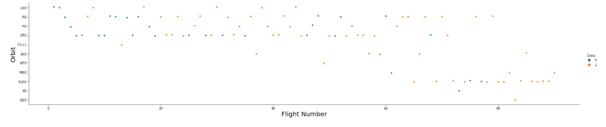
Flight Number vs. Orbit Type
We founded that LEO has the higher success rate related to the number of flights and also in the GTO orbit, there is no relationship between flight number and the orbit.

Slide 22
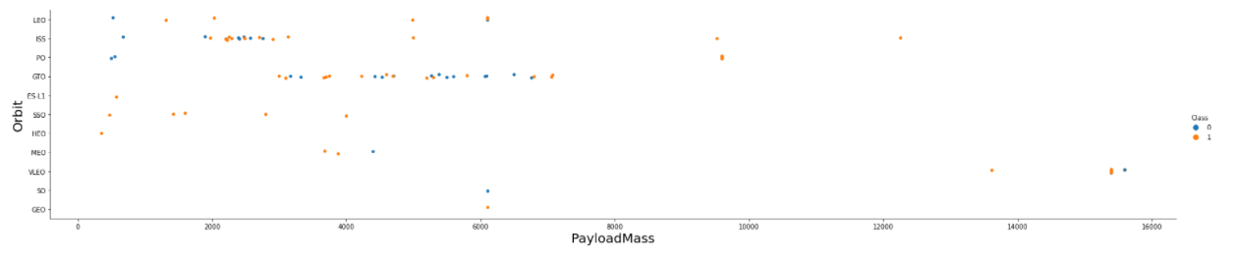
Payload vs. Orbit Type
We observed that larger the payloadmass have positive impact on LEO and ISS Orbits and negative impact on GTO orbits.

Slide 23
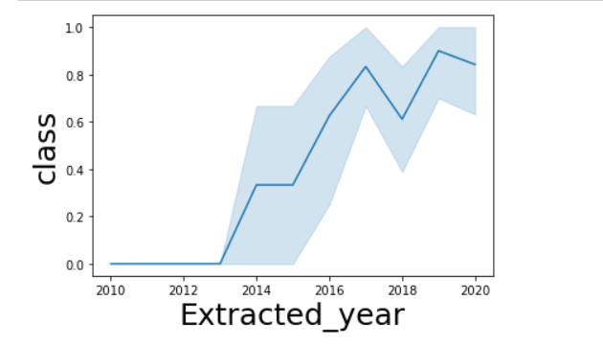
Launch Success Yearly Trend
We can observe that success rate has kept increasing from 2013 to 2020.

Slide 24
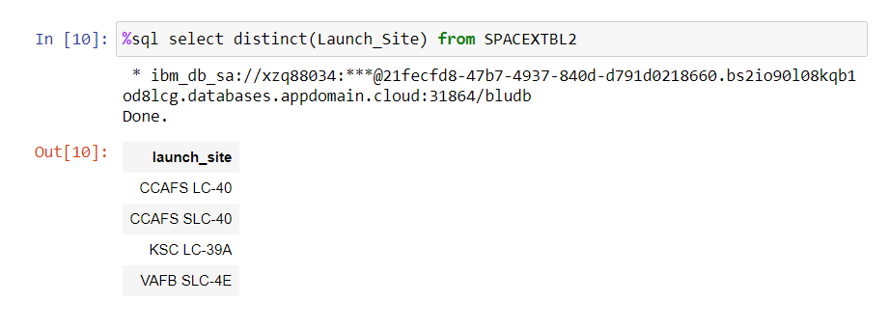
All Launch Site Names
We used DISTINCT function to show the unique launch sites.

Slide 25
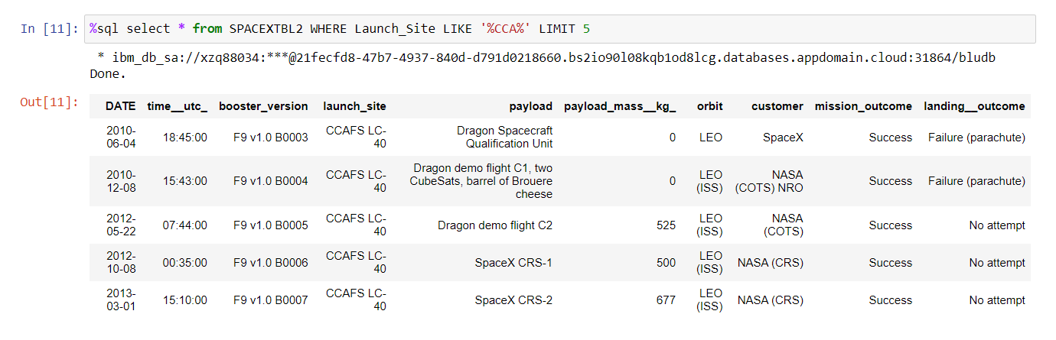
Launch Site Names Begin with 'CCA'
We used wildcard like % to filter out the results and LIMIT function to show only 5 records.

Slide 26
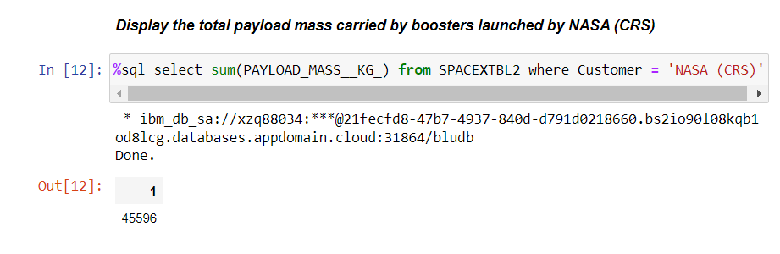
Total Payload Mass
We used SUM function to calculate the total payload mass .

Slide 27
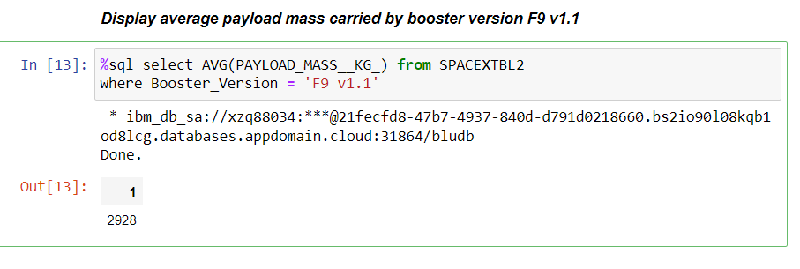
Average Payload Mass by F9 v1.1
We calculated the average payload mass carried by booster version using AVG function.

Slide 28
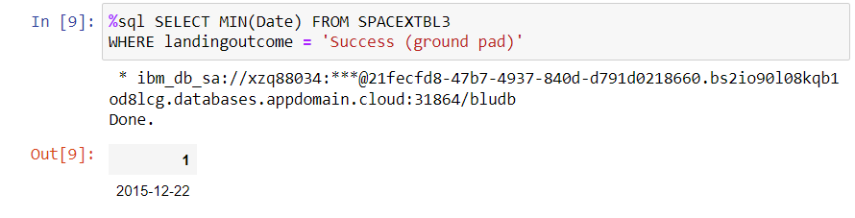
First Successful Ground Landing Date
We observed that the dates of the first successful landing outcome on ground pad was 22nd December 2015

Slide 29
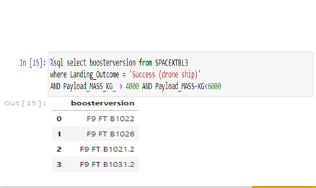
Successful Drone Ship Landing with Payload between 4000 and 6000
We used the WHERE clause to filter for boosters which have successfully landed on drone ship and applied the AND condition to determine successful landing with payload mass greater than 4000 but less than 6000

Slide 30
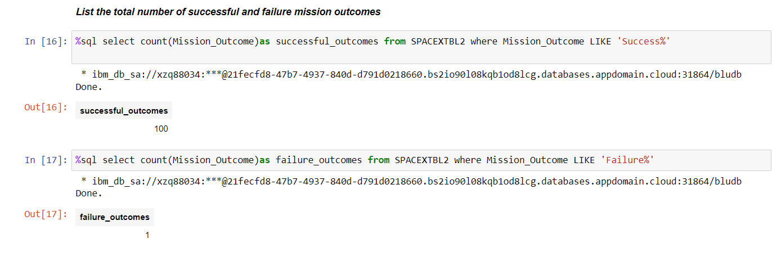
Total Number of Successful and Failure Mission Outcomes
We used ‘%’ wildcard to filter for WHERE MissionOutcome was a success or a failure.

Slide 31
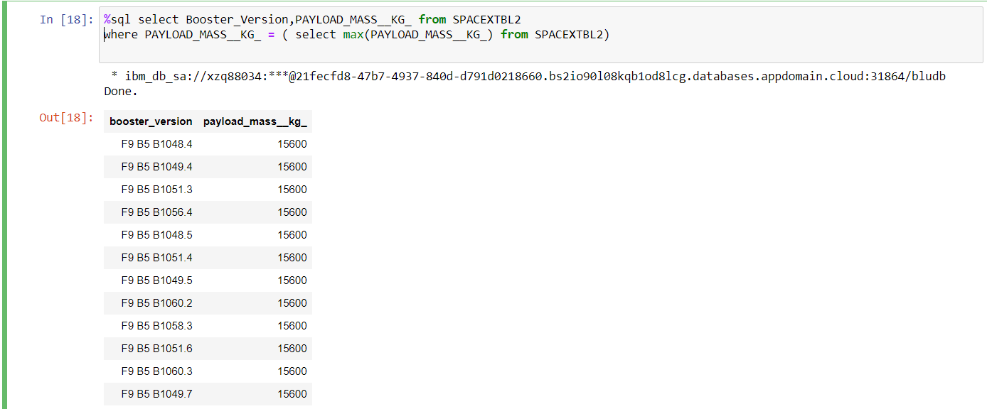
Boosters Carried Maximum Payload
We founded that booster version with maximum payload by using sub query in the WHERE clause and using MAX function.

Slide 32
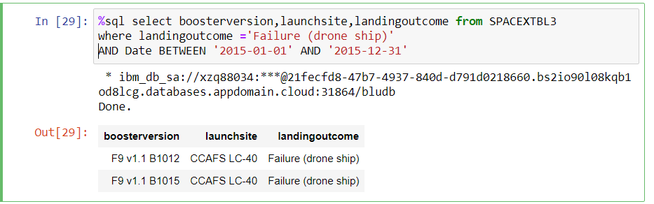
2015 Launch Records
We used a combinations of the WHERE clause, LIKE, AND, and BETWEEN conditions to filter for failed landing outcomes in drone ship, their booster versions, and launch site names for year 2015

Slide 33
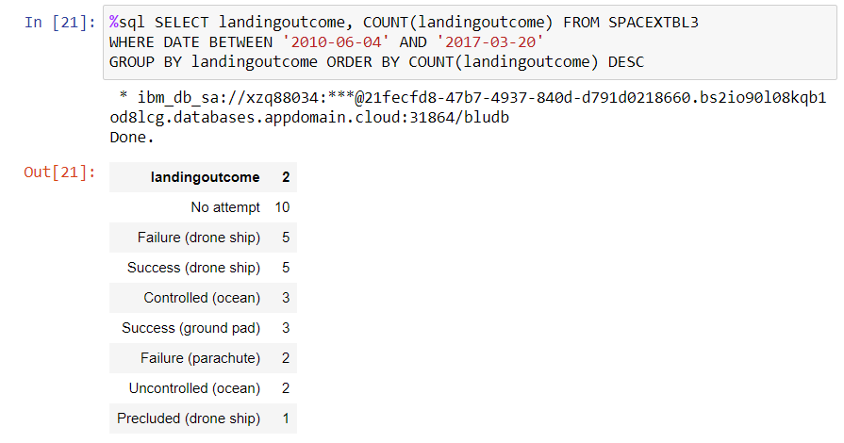
Rank Landing Outcomes Between 2010-06-04 and 2017-03-20
We used the function COUNT counts the records in the column.
We applied the GROUP BY clause to group the landing outcomes and the ORDER BY clause to order the grouped landing outcome in descending order.

Slide 34

Section 3

Slide 35
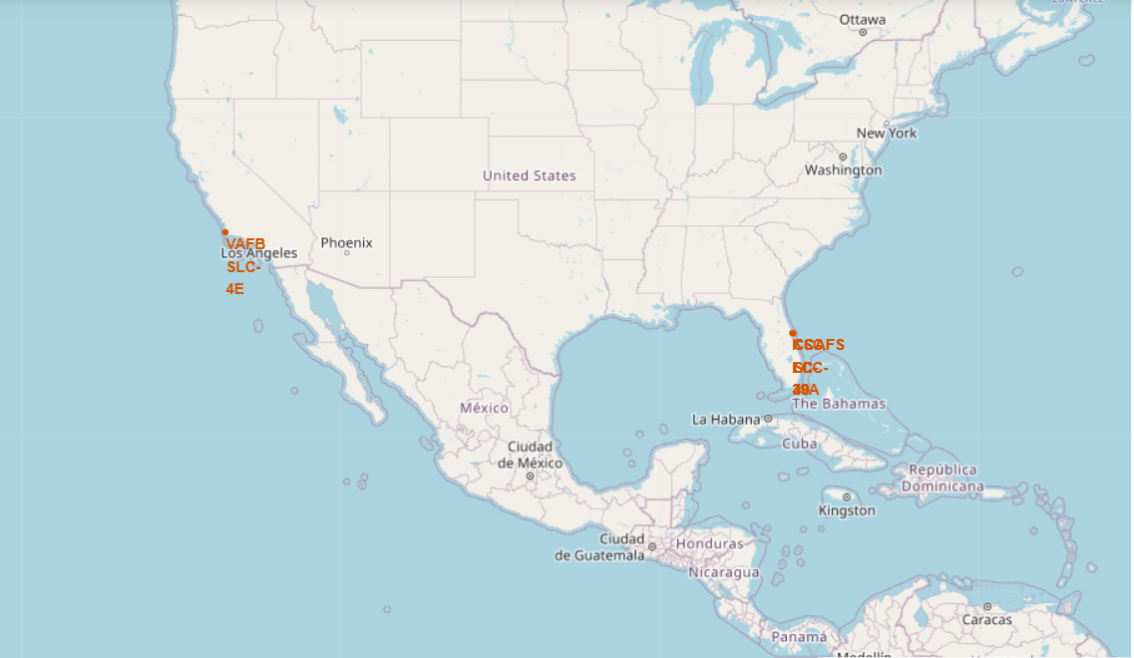
Launch Site Locations Map
SpaceX has one launch site on the California and rest of the launch sites are located on the Florida.

Slide 36
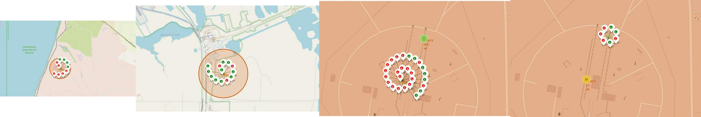
Markers showing launch sites with color labels
Red marker shows failure launches and green marker shows successful launches.

Slide 37
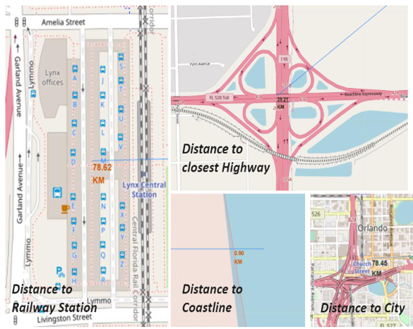
Launch Site distance to landmarks
Are launch sites in close proximity to railways?NO
Are launch sites in close proximity to highways?NO
Are launch sites in close proximity to coastline?YES
Do launch sites keep certain distance away from cities?YES

Slide 38

Section 4

Slide 39
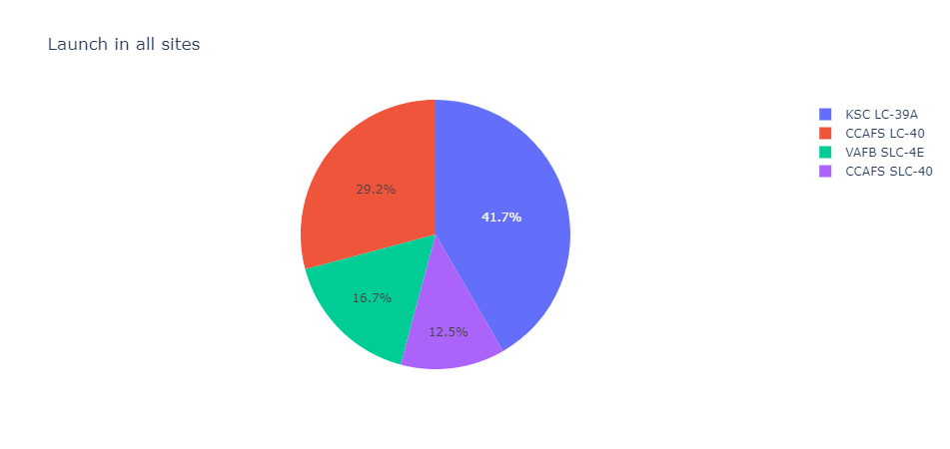
Pie chart showing the success percentage achieved by each launch site
KSC LC-39 A location has highest successful launches.

Slide 40
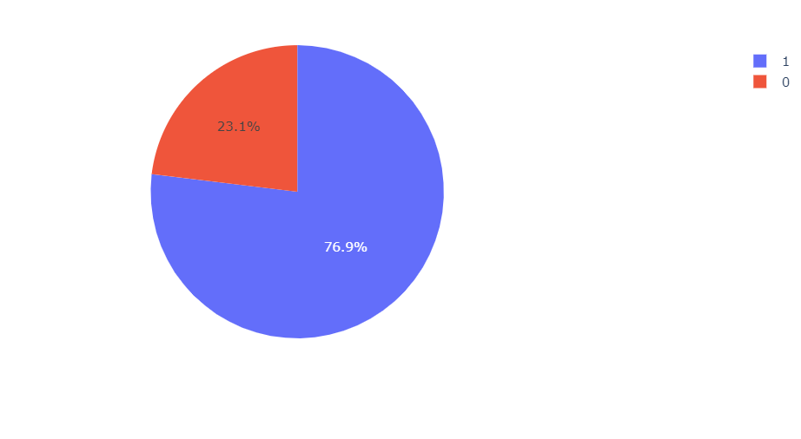
Most sucessful Launch site
KSC LC-39 A has achieved a success rate of 76.9% .

Slide 41
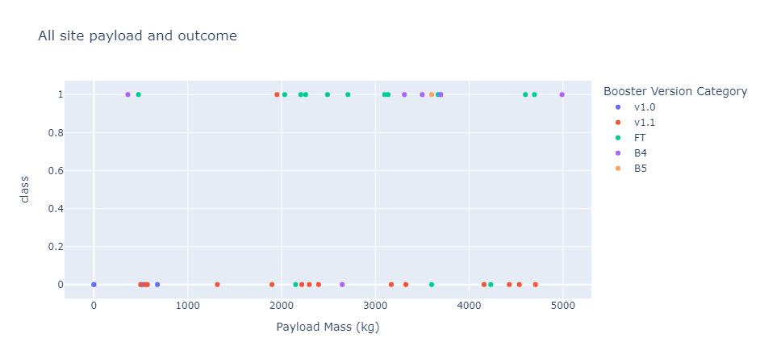
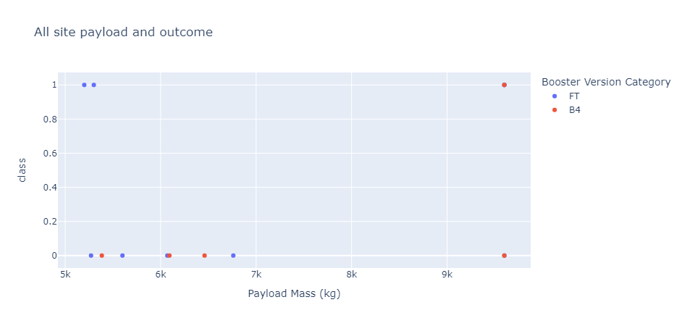
Payload vs Launch Outcome Scatter Plot
The most successful payload range appears to be from 2000-4500kg

Slide 42

Section 5

Slide 43
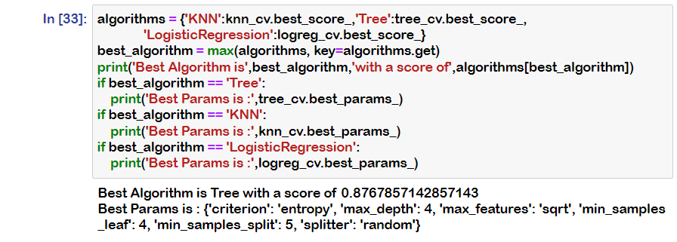
Classification Accuracy
Best algorithm is DecisionTree classifier with a score of 0.87.

Slide 44
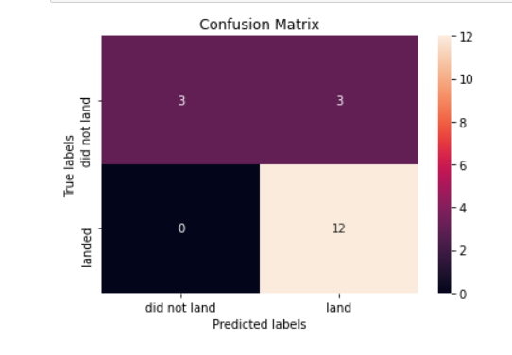
Confusion Matrix
Here our DecisionTree classifier was mostly accurate but it has shown false positives,it wrongly predicted three landings which is successful when they are not been successful.

Slide 45
Conclusions
Best algorithm for this task is decision tree classifier.
The most successful payload range appears to be from 2000-4500kg.
KSC LC-39 A location has highest successful launches and KSC LC-39 A has achieved a success rate of 76.9%.
Success rate has kept increasing from 2013 to 2020.
Orbit ES-L1, GEO, HEO, SSO, VLEO had the most success rate.
The greater the payload mass for launch site higher the Success rate for the rocket.

Slide 46


